Slide 1
Title IX
For Graduate Assistants

Slide 2
Why is this important?
University commitment to creating an inclusive, welcoming environment for students and employees
Support offered to those impacted by these issues
Everyone has a role
Notes:
Mike Strong

Slide 3
What is title ix?
The type of conduct that is required to be reported includes but is not limited to:
Sexual misconduct, which includes any sexual act directed against another person without their consent, including sexual assault, sexual exploitation, and indecent exposure.
Intimate partner violence or interpersonal violence (dating violence, domestic violence, stalking, battery).
Sexual harassment (quid pro quo, hostile environment, retaliation).
Gender-based discrimination.
Retaliation against any individual for reporting conduct under Title IX, participating in an investigation under Title IX or acting as a witness in a Title IX investigation or proceeding.
Notes:
Chelsea Polly

Slide 4
Why Should I report?
UA conducted a study in 2022 to determine the experiences of its students
837 students responded
  12% stated they had been stalked
  16% stated they had been subjected to non-consensual sexual contact
  6% stated they had been subjected to non-consensual sexual intercourse
  8% stated they had been subjected to interpersonal violence
  *Knowing that our students, faculty and/or staff have experienced such behaviors requires steps to provide help and support.
Notes:
Chelsea Polly

Slide 5
How can you help?
Validate how that person is feeling
Let them control the process as much as possible
Offer support and listen without judgment
  “I’m sorry this happened”
  “Is there anything I can do that would be most helpful?”
Do NOT promise confidentiality
  You can state that it will be reported but that they will be able to determine how to move forward
Notes:
Mike Strong

Slide 6
Responding to students
Make reporting obligations known as early as possible
Educate yourself
  Warning signs
  Resources
  Reporting process
Establish a culture of respect
Notes:
Mike Strong

Slide 7
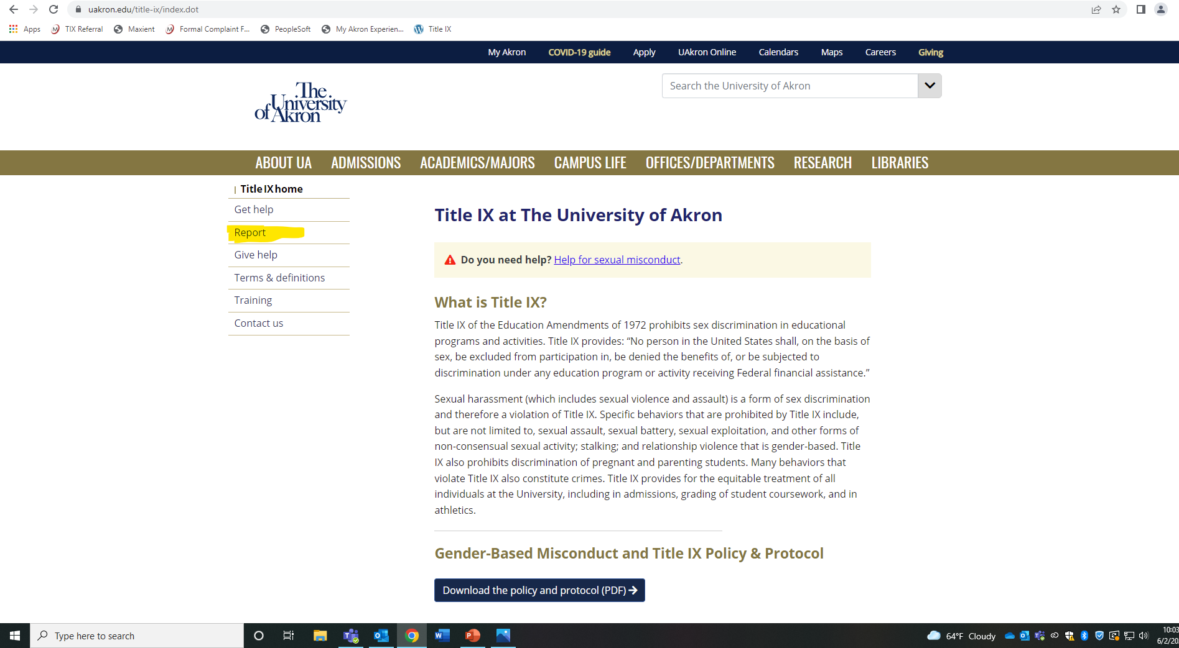
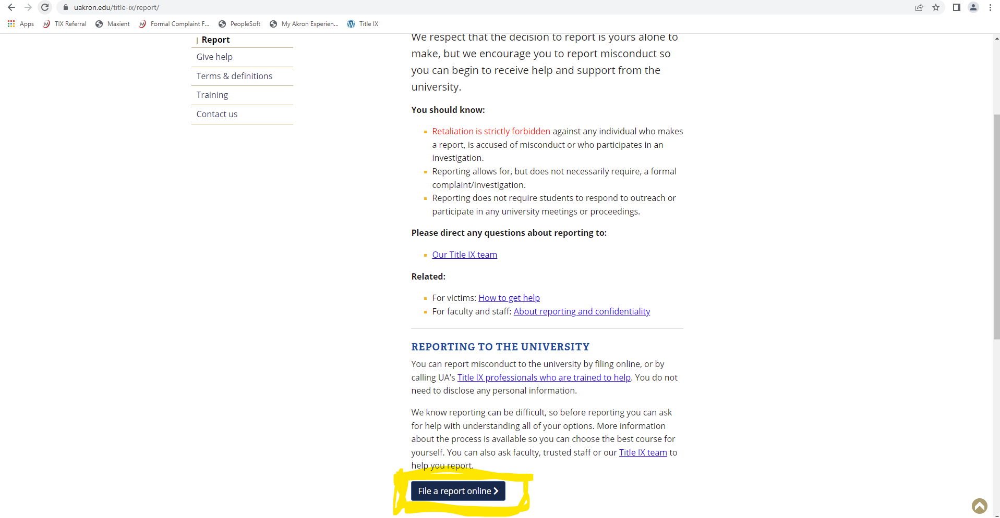
Submitting a Report
https://cm.maxient.com/reportingform.php?UnivofAkron&layout_id=11
Notes:
Chelsea

Slide 8
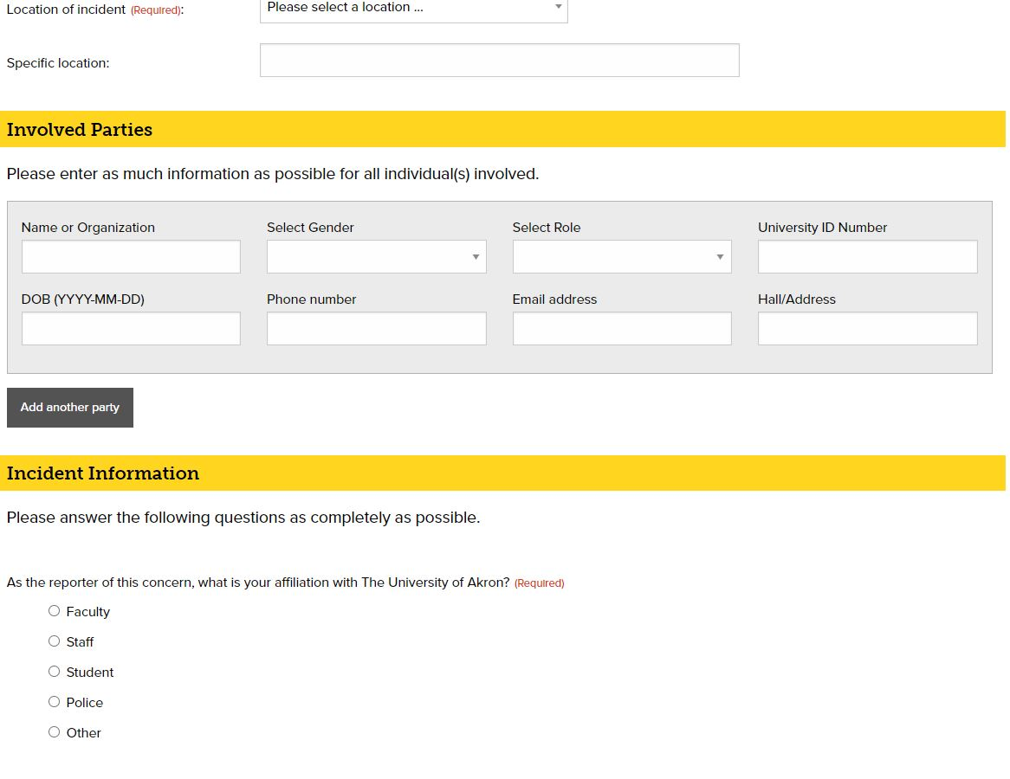
Notes:
Chelsea

Slide 9
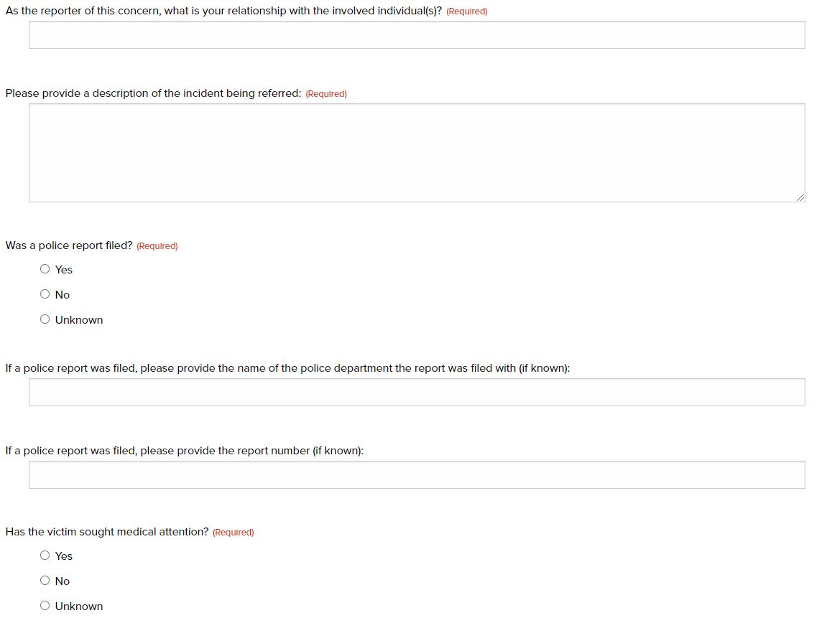
Notes:
Chelsea

Slide 10
follow up
Responding after the report
  It is okay to say hello or ask how they are doing
  Allow the student to bring up the events if they wish to do so
  Keep the information private
  Don’t treat the student differently
Notes:
Mike

Slide 11
What happens next?
A Deputy Title IX Coordinator will reach out to the individual to offer support and discuss options. It is their choice if they wish to participate in the process
If the individual wishes to proceed, the issue will be investigated with both parties receiving notice and having the opportunity to participate in the investigation
A hearing is held after the investigation to determine responsibility
Notes:
Mike

Slide 12
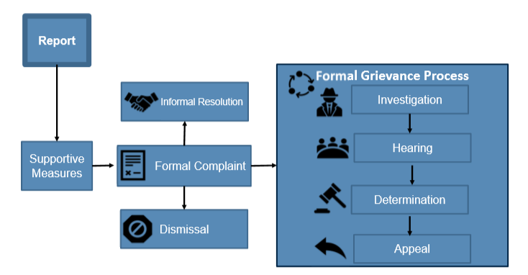
Path of reporting
Notes:
Chelsea

Slide 13
You should know…
Retaliation is strictly forbidden against any individual who makes a report, is accused of misconduct or who participates in an investigation.
Reporting allows for, but does not necessarily require, a formal complaint/investigation.
Reporting does not require students to respond to outreach or participate in any University meetings or proceedings.
Notes:
Mike

Slide 14
Title IX contacts
Chelsea Polly – Title IX Coordinator
  330-972-7276 or cpolly@uakron.edu
Mike Strong – Deputy Title IX Coordinator for Students
  330-972-6048 or mstrong@uakron.edu
Jacklin Wallgren – Deputy Title IX Coordinator for Athletics
  330-972-5512 or jwallgren@uakron.edu

Slide 15
Confidential Resources
Hope & Healing (Rape Crisis Center) – Suite 246 Rec Center – 330-434-7273 (24/7 hotline)
Counseling & Testing Center – Simmons 306
Student Health Services – Suite 260 Rec Center
Support Guide

Slide 16
Thank you for listening!

